Slide 1
ECE158A: Computer Networks
Tara Javidi
Lectures: TTH 5:00-5:30pm Center Hall 222
Topic 7
Queuing Theory: Link-Layer Analytic Framework

Slide 2
A Simple Queuing System
Average Wait
in Queue (W_{q} )
Service
Arrival Rate (λ )
Departure
Average Number
in Queue (L_{q} )
Rate (μ )
Avg Time in System (W )
Avg Number in System (L )

Slide 3
Basic Terminology
Queuing system
Data network where packets arrive, wait in various queues, receive service at various points, and exit after some time
Arrival rate
Long-term number of arrivals per unit time
Occupancy
Number of packets in the system (averaged over a long time)
Time in the system (delay)
Time from packet entry to exit (averaged over many packets)

Slide 4
Components of a Basic Queuing Process
Input Source
The Queuing System
Served Jobs
Packet Types
Jobs
Service Mechanism
Queue
leave the system
Arrival Process
Queue Discipline
(order of service)
Service Process
Configuration
of Queue(s)

Slide 5
1. The Packet Types
Population of packets and their size characteristics
The size can be fixed or varying (random)
The latter is most common
Can be
Homogeneous: Only one type of packets (easiest to handle)
Heterogeneous: Several different kinds of packets

Slide 6
2. Arrival Process
In what pattern do packets arrive to the queueing system?
Distribution of arrival times?
Batch arrivals?
Finite many packets?
Finite queue length?
Memoryless arrival process often assumed
First order approximation for Many real-world arrival processes which do not have heavy dependency across time

Slide 7
3. Service Process
How long does it take to transfer/communicate packets?
Distribution of service times?
Retransmission (fully or incremental redundancy)?
Hardware/service breakdown?
Memoryless service times is a good start
Works well for wireless channels with short memory (and not too long-term dependence)

Slide 8
4. Number of Servers
How many service lines are available?
Single Server Queue
Multiple Server Queue

Slide 9
Example – Two Queue Configurations
Multiple Queues
Single Queue
Servers
Servers

Slide 10
5. Queue Discipline
How are packets selected from the queue for service?
First Come First Served (FCFS)
Shortest Processing Time (SPT)
Earliest Due Date (EDD)
Priority (jobs are in different priority classes)
FCFS default assumption for most systems

Slide 11
Discrete Time M/M/1 Queue
At any given time slot a packet arrives with probability λ
At any given time slot a packet/flow/file is successfully transmitted with probability μ
Independent and identical across time
Assume a finite buffer size B

Slide 12
M/M/1 Analysis

Slide 13
M/M/1 Analysis

Slide 14
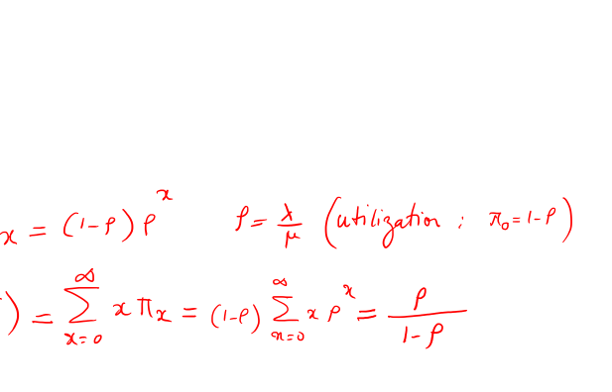
M/M/1 Analysis

Slide 15
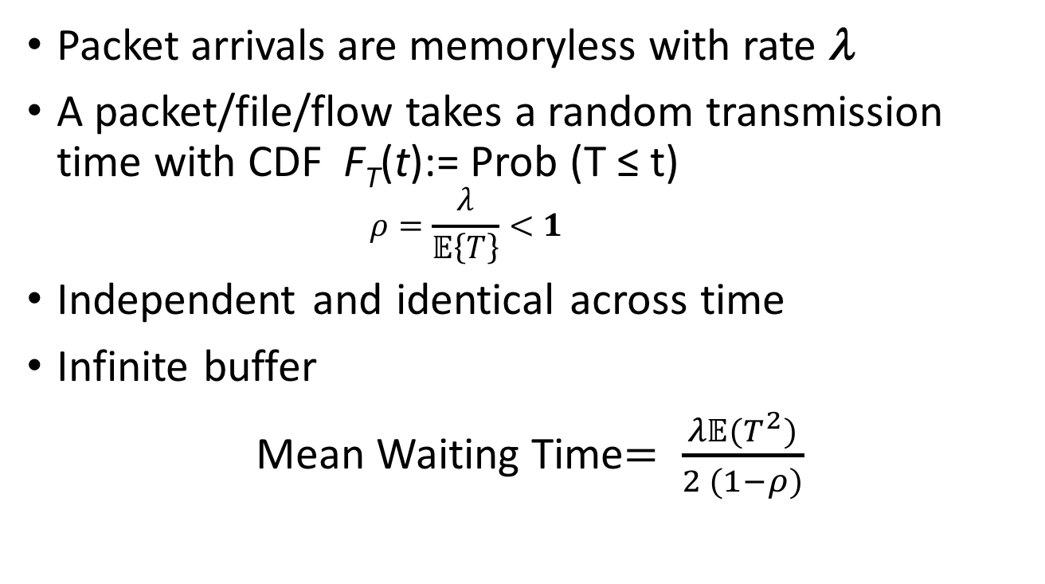
M/G/1 Queue
Packet arrivals are memoryless with rate λ
A packet/file/flow takes a random transmission time with CDF F_{T}(t):= Prob (T ≤ t)
$$ρ=\frac{λ}{𝔼\left\{T\right\}}<1$$
Independent and identical across time
Infinite buffer
Mean Waiting Time$= \frac{λ𝔼(T^{2})}{2 (1−ρ)}$

Slide 16
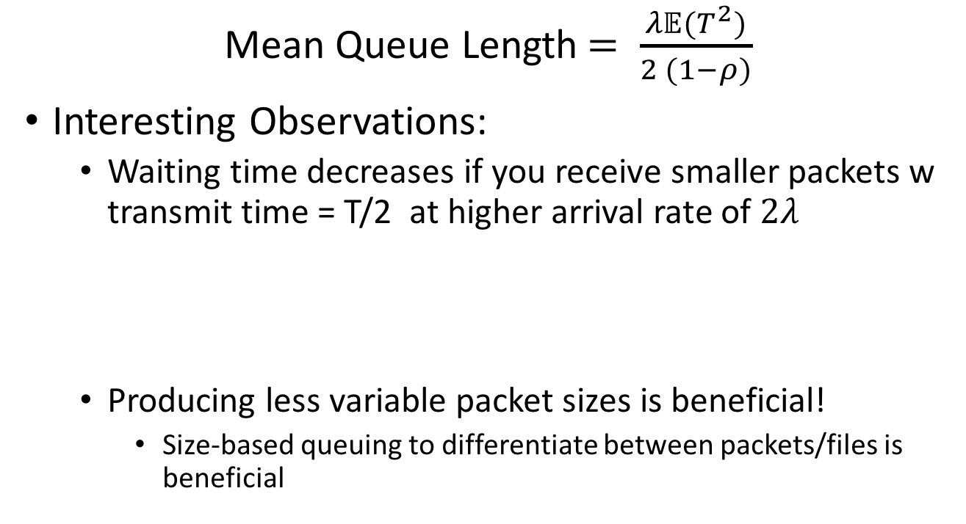
M/G/1 Queue
Mean Queue Length$= \frac{λ𝔼(T^{2})}{2 (1−ρ)}$
Interesting Observations:
Waiting time decreases if you receive smaller packets w transmit time = T/2 at higher arrival rate of $2λ$
Producing less variable packet sizes is beneficial!
Size-based queuing to differentiate between packets/files is beneficial

Slide 17
Packet Switching and Forwarding
“4”
Link 1, ingress
Choose
Egress
Link 1, egress
Link 2
Link 2, ingress
Choose
Egress
Link 2, egress
R1
“4”
Link 1
Link 3
Link 3, ingress
Choose
Egress
Link 3, egress
Link 4
Link 4, ingress
Choose
Egress
Link 4, egress
If we can write on egress N times faster than the ingress/egress line rate we can allow simultaneous access by queuing packets at the output

Slide 18
Output Queueing
Packets from multiple inputs can be written on a single output
Queued to resolve the read conflict
Conceptually simple
“Write” is often done in hardware via crossbar (for speed)
Expensive to switch N times faster (esp for large N)

Slide 19
Input Queueing
Packets are queued at each input
Conceptually simple
If used w FCFS, then low utilization due to HoL blocking
Can cause throughput to be limited to 58.6%
switch
fabric
output port contention:
only one red datagram can be transferred. lower red packet is blocked
one packet time later: green packet experiences HOL blocking

Slide 20
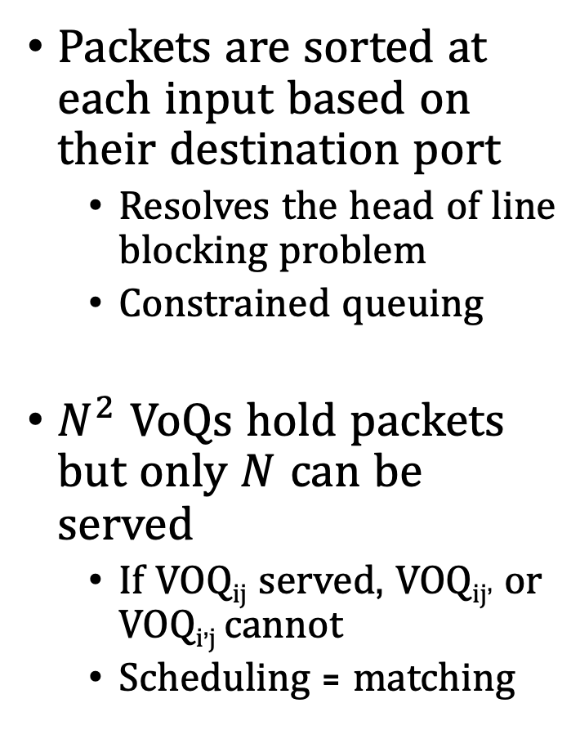
Virtual Output Queueing
Packets are sorted at each input based on their destination port
Resolves the head of line blocking problem
Constrained queuing
$N^{2}$ VoQs hold packets but only $N$ can be served
If VOQ_{ij} served, VOQ_{ij’} or VOQ_{i’j} cannot
Scheduling = matching
Scheduling Matrix

Slide 21
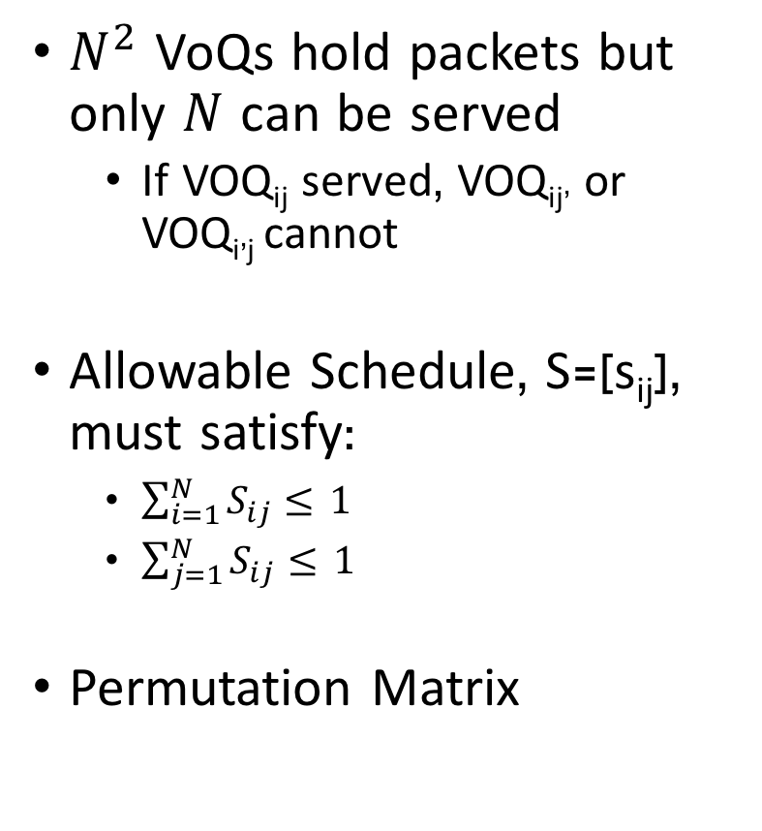
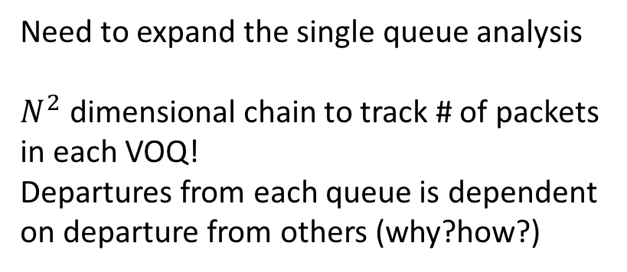
Scheduling Matrix
$N^{2}$ VoQs hold packets but only $N$ can be served
If VOQ_{ij} served, VOQ_{ij’} or VOQ_{i’j} cannot
Allowable Schedule, S=[s_{ij}], must satisfy:
$\sum_{i=1}^{N}{S_{ij}≤} 1$
$\sum_{j=1}^{N}{S_{ij}≤} 1$
Permutation Matrix
Scheduling Matrix
(matching)
Need to expand the single queue analysis
$N^{2}$ dimensional chain to track # of packets
in each VOQ!
Departures from each queue is dependent
on departure from others (why?how?)

Slide 22
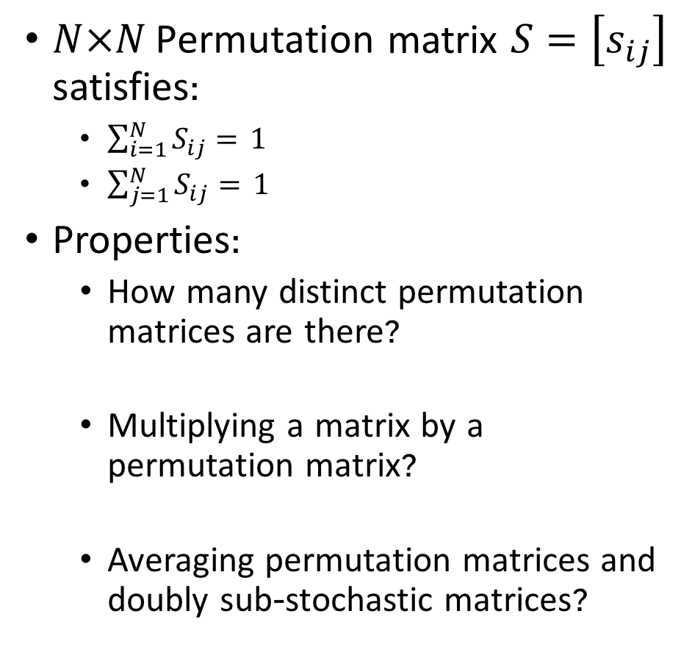
Permutation Matrices
$N×N \text{Permutation}$matrix $S=\left[s_{ij}\right]$ satisfies:
$\sum_{i=1}^{N}{S_{ij}=} 1$
$\sum_{j=1}^{N}{S_{ij}=} 1$
Properties:
How many distinct permutation matrices are there?
Multiplying a matrix by a permutation matrix?
Averaging permutation matrices and doubly sub-stochastic matrices?

Slide 23
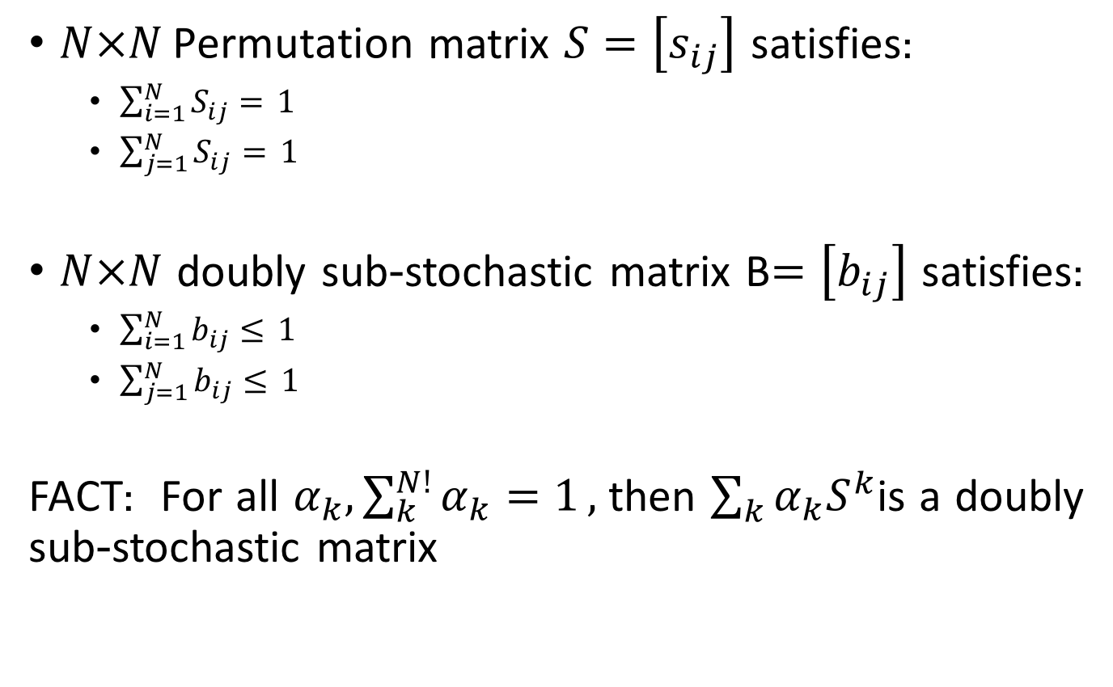
Permutation Matrices
$N×N \text{Permutation}$matrix $S=\left[s_{ij}\right]$ satisfies:
$\sum_{i=1}^{N}{S_{ij}=} 1$
$\sum_{j=1}^{N}{S_{ij}=} 1$
$N×N$doubly sub-stochastic matrix B$=\left[b_{ij}\right]$ satisfies:
$\sum_{i=1}^{N}{b_{ij}≤} 1$
$\sum_{j=1}^{N}{b_{ij}≤} 1$
FACT: For all $α_{k},\sum_{k}^{N!}{α_{k}=1},$then $\sum_{k}{α_{k}S^{k}}$is a doubly sub-stochastic matrix

Slide 24
Scheduling Matrix
$N^{2}$ VoQs hold packets but only $N$ can be served
If VOQ_{ij} served, VOQ_{ij’} or VOQ_{i’j} cannot
Allowable Schedule, S=[s_{ij}], must satisfy:
$\sum_{i=1}^{N}{S_{ij}≤} 1$
$\sum_{j=1}^{N}{S_{ij}≤} 1$
Permutation Matrix
Scheduling Matrix
Need to expand the single queue analysis
$N^{2}$ dimensional chain to track # of packets
in each VOQ!
Departures from each queue is dependent
on departure from others (why?how?)

Slide 25
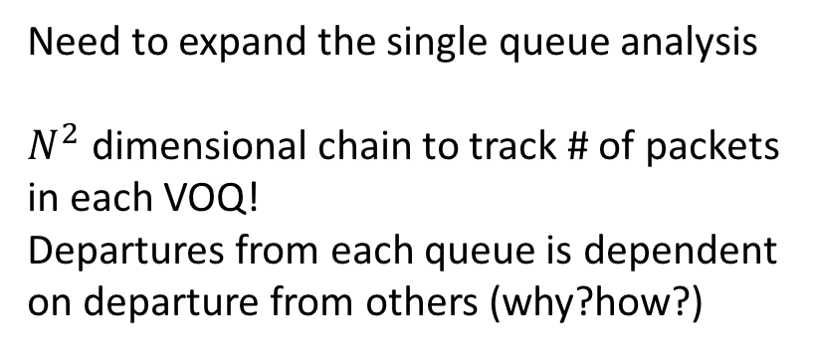
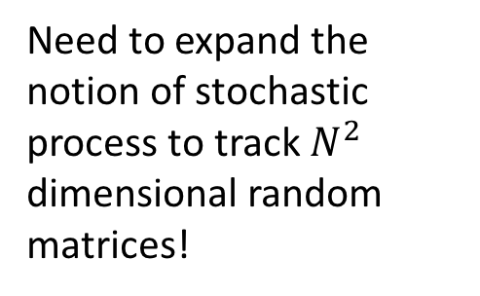
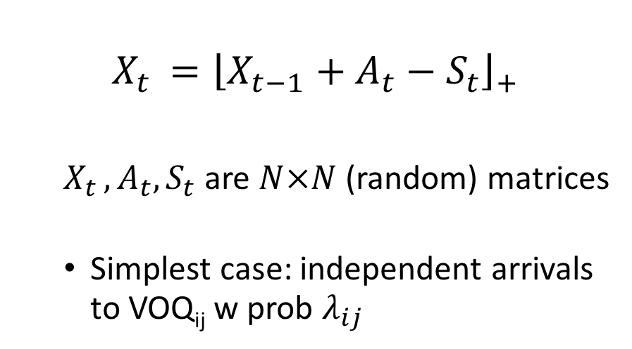
General Formalism
Need to expand the single queue analysis
$N^{2}$ dimensional chain to track # of packets
in each VOQ!
Departures from each queue is dependent
on departure from others (why?how?)
$$X_{t }={\left\lfloor X_{t−1}+A_{t}−S_{t}\right\rfloor }_{+}$$
$X_{t }, A_{t}, S_{t}$ are $N×N$ (random) matrices
Simplest case: independent arrivals to VOQ_{ij} w prob $λ_{ij}$
Scheduling Matrix
Need to expand the notion of stochastic process to track $N^{2}$ dimensional random matrices!

Slide 26
Solution Methodologies
Analytical results (formulas)
Pros: Quick answers, insight
Cons: Often inaccurate or inapplicable
Explicit simulation
Pros: Accurate and realistic models, broad applicability
Cons: Can be slow
Hybrid simulation
Intermediate solution approach
Combines advantages and disadvantages of analysis and simulation
Original content: D. Bertsekas, MIT

Slide 27
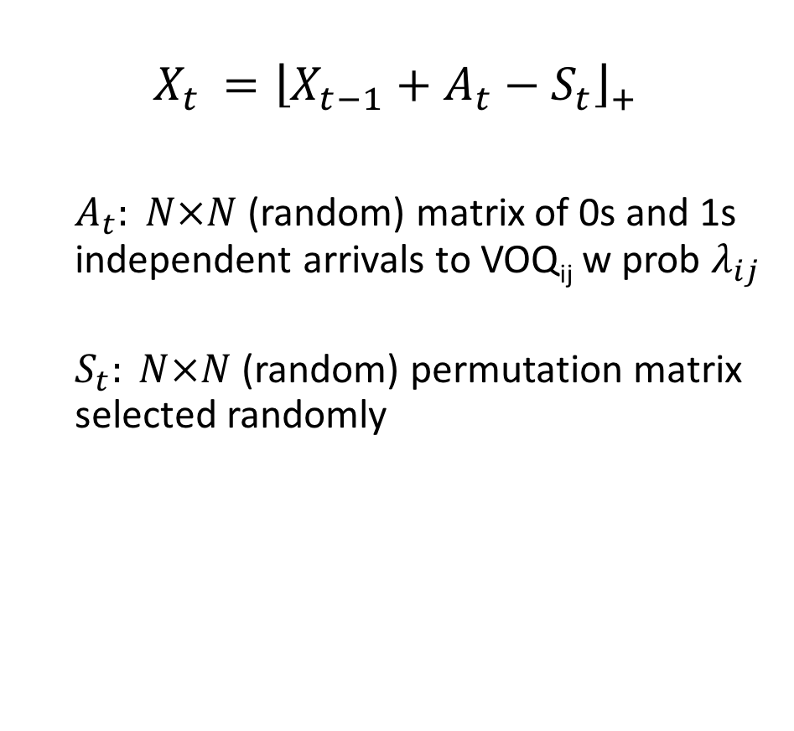

Randomized Scheduling
$$X_{t }={\left\lfloor X_{t−1}+A_{t}−S_{t}\right\rfloor }_{+}$$
$A_{t}: N×N$ (random) matrix of 0s and 1s independent arrivals to VOQ_{ij} w prob $λ_{ij}$
$S_{t}: N×N$ (random) permutation matrix selected randomly
Scheduling Matrix
Need to expand the notion of stochastic process to track $N^{2}$ dimensional random matrices!

Slide 28
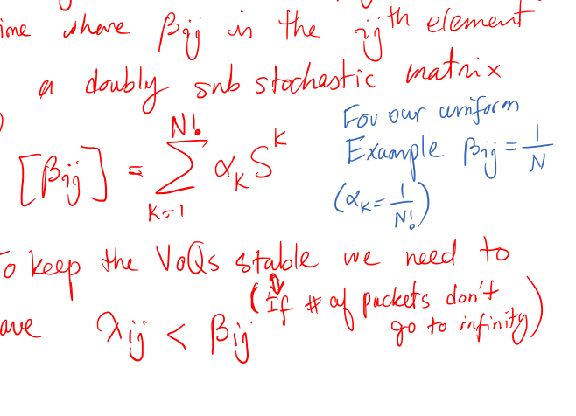
Analysis

Slide 29
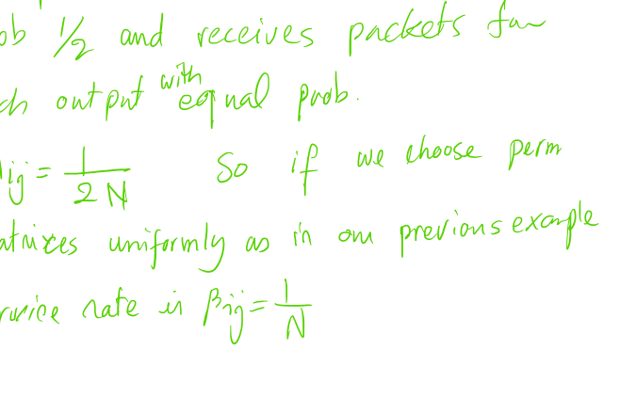
Analysis

Slide 30
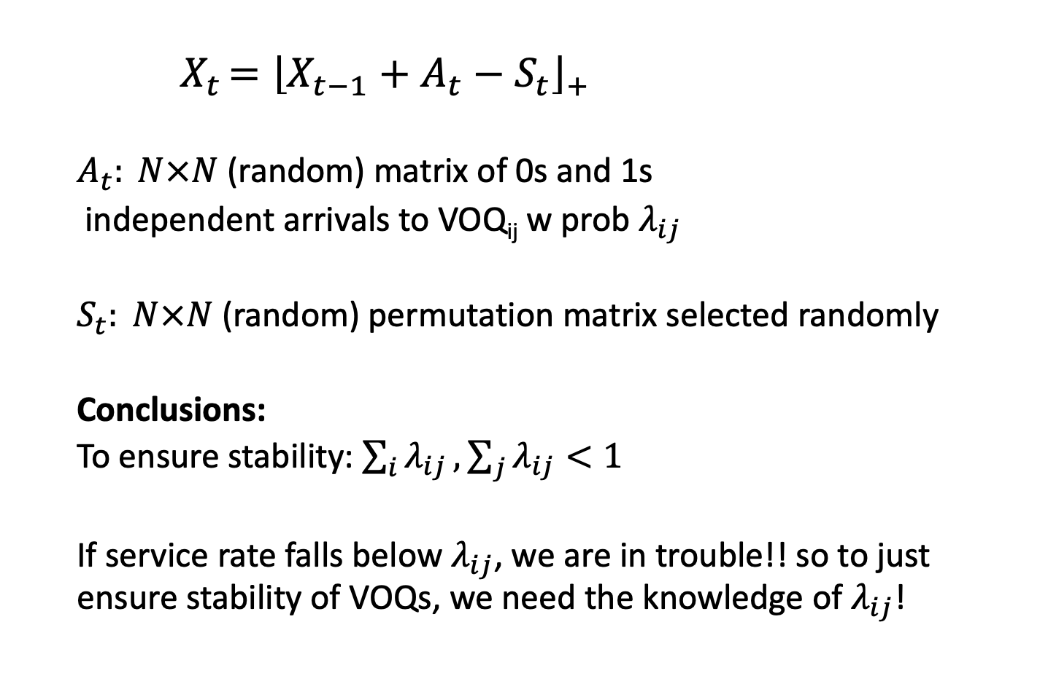
Randomized Scheduling
$${ X}_{t }={\left\lfloor X_{t−1}+A_{t}−S_{t}\right\rfloor }_{+}$$
$A_{t}: N×N$ (random) matrix of 0s and 1s
independent arrivals to VOQ_{ij} w prob $λ_{ij}$
$S_{t}: N×N$ (random) permutation matrix selected randomly
Conclusions:
To ensure stability: $\sum_{i}{λ_{ij}},\sum_{j}{λ_{ij}}<1$
If service rate falls below $λ_{ij}$, we are in trouble!! so to just ensure stability of VOQs, we need the knowledge of $λ_{ij}$!
Scheduling Matrix

Slide 31
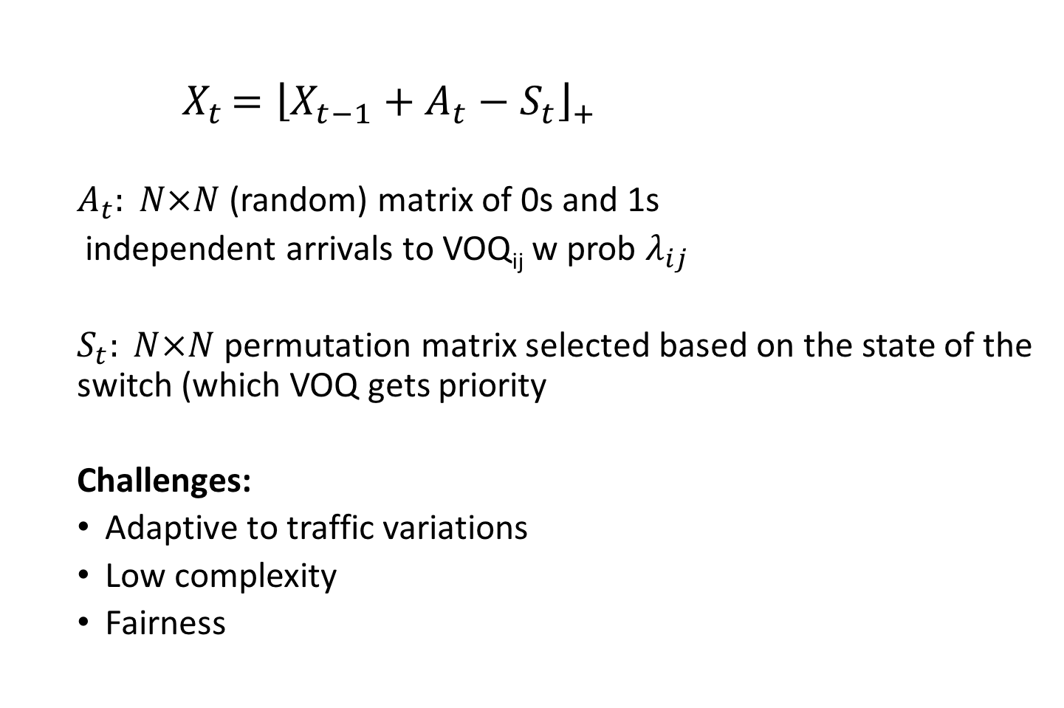
Stable Scheduling
$${ X}_{t }={\left\lfloor X_{t−1}+A_{t}−S_{t}\right\rfloor }_{+}$$
$A_{t}: N×N$ (random) matrix of 0s and 1s
independent arrivals to VOQ_{ij} w prob $λ_{ij}$
$S_{t}: N×N$ permutation matrix selected based on the state of the switch (which VOQ gets priority
Challenges:
Adaptive to traffic variations
Low complexity
Fairness
Scheduling Matrix

Slide 32
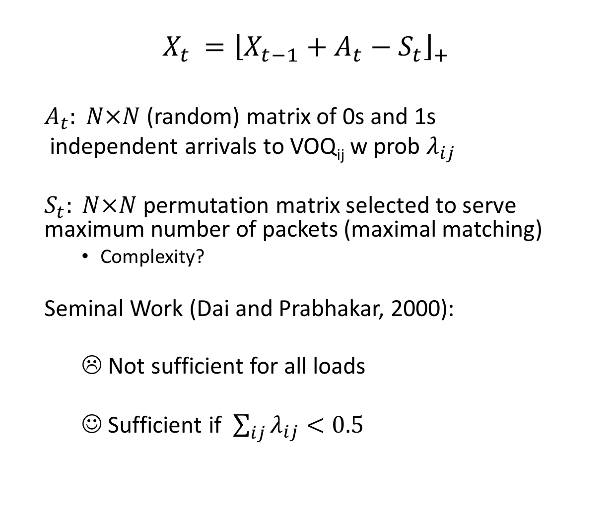
Maximal Scheduling
$$X_{t }={\left\lfloor X_{t−1}+A_{t}−S_{t}\right\rfloor }_{+}$$
$A_{t}: N×N$ (random) matrix of 0s and 1s
independent arrivals to VOQ_{ij} w prob $λ_{ij}$
$S_{t}: N×N$ permutation matrix selected to serve maximum number of packets (maximal matching)
Complexity?
Seminal Work (Dai and Prabhakar, 2000):
☹ Not sufficient for all loads
☺ Sufficient if $\sum_{ij}{λ_{ij}}<0.5$
Scheduling Matrix
Or equivalently switch speed up of 2 ☺

